Slide 1
Package in java
A package as the name suggests is a pack(group) of classes, interfaces and other packages. In java we use packages to organize our classes and interfaces.
Why we use package:
1)Java package is used to categorize the classes and interfaces so that they can be easily maintained.
2) Java package provides access protection.
3) Java package removes naming collision.
So by using package, we can create classes by same name and no naming collision are there. We can store it in different package and provide access control.

Slide 2
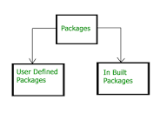
Types of packages
Package in java can be categorized in two form, built-in package and user-defined package.
Built In Package:They are already built in standard java package.Eg. lang,io,awt,applet,utill,net etc…Other included later in java editions..
User Defined Package:They are created by java users by using built-in packages.

Slide 3
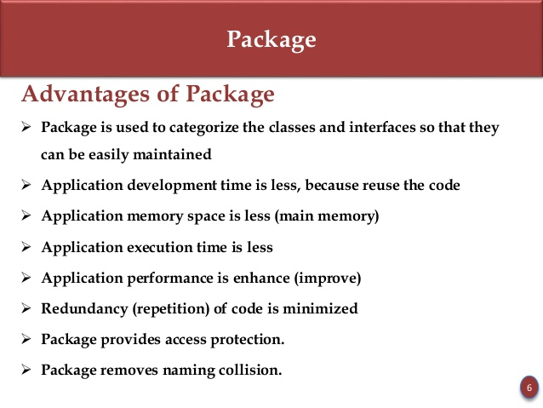
Advantage of package

Slide 4
How to create a package(user defined)
Syntax:-To create a package
package packagename
public class classname
{
methods defination();
}
Example:
package a
public class AA
{
public void display()
{
System.out.println(“we are using class AA of package a”);
}
}

Slide 5
How to access/use the package
Syntax:
Import packagename..class;//for particular class of package
Or
Import packagename.*;//for all the classes in package
Example:
import a.*;
class BB{
public static void main(String args[]){
AA obj = new AA();
obj.display();
}
}

Slide 6
output
we are using class AA of package a.
To add more class in same package
As we know ,package is group of classes and classes are group of methods.So to add more classes in same package we make the class public.
Example:
package a
public class ZZ
{
public void show()
{
System.out.println(“we are using class ZZ of package a”);
}

Slide 7
Things to be Remember in Packages
Package name of inbuilt package always start with small case letter.
In Package hierarchy ,package is always first statement.
Ex: package packagename
We have to add one class at time. So that we make it public and compile with the same name. To add another class we make that class public and compile with that class name.
To hide a class we could not make it public.
Package should be save in the same directory as packagename.
Package hierarchy always be:
Import packagename.subpackagename.classname;

Slide 8
Thanks………

